Slide 1
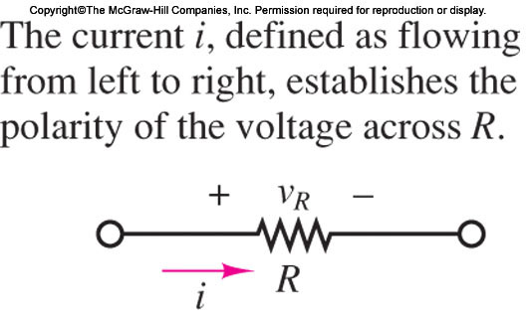
Review of Analysis Methods by Examples

Slide 2
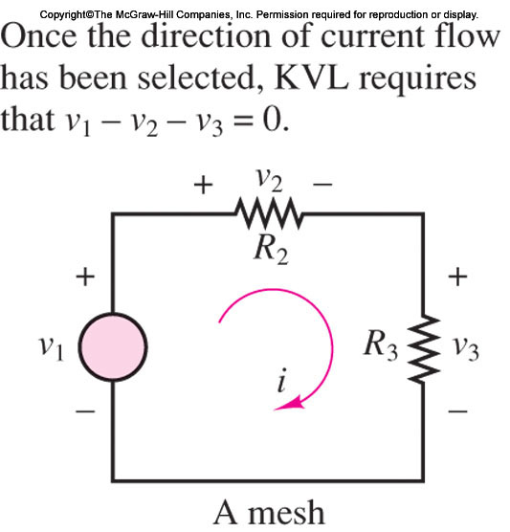
Review of Analysis Methods by Examples

Slide 3
Review of Analysis Methods by Examples
Example (textbook, Pages 72,73)
Node Analysis with Voltage Sources
The circuit of Figure 3.10 is used to illustrate how node analysis is applied to a circuit containing voltage sources.
Once again, we follow the steps outlined in
the Focus on Methodology box.

Slide 4
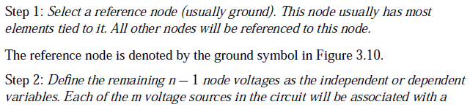
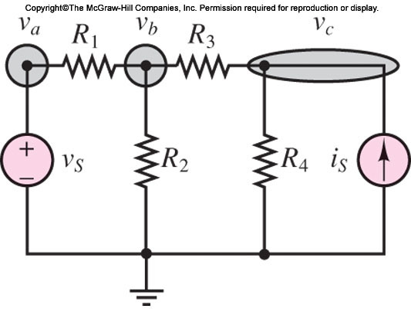
Review of Analysis Methods by Examples
Example (textbook, Pages 72,73)

Slide 5
Review of Analysis Methods by Examples
Example (textbook, Pages 72,73)

Slide 6
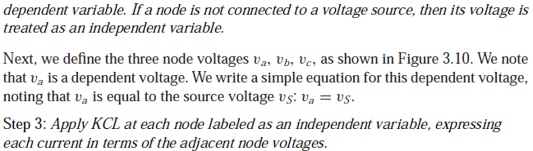
Review of Analysis Methods by Examples
Example (textbook, Pages 72,73)

Slide 7
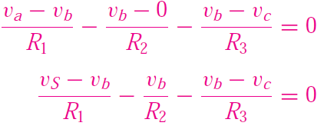

Review of Analysis Methods by Examples
Example (textbook, Pages 72,73)
We apply KCL at the two nodes associated with the independent variables vb and vc:
At node b:
At node c:

Slide 8
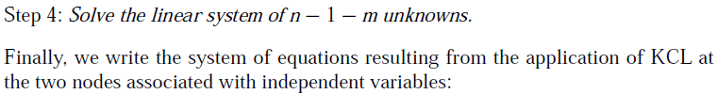
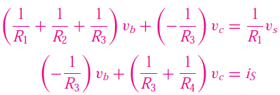
Review of Analysis Methods by Examples
Example (textbook, Pages 72,73)
The resulting system of two equations in two unknowns can now be solved.

Slide 9
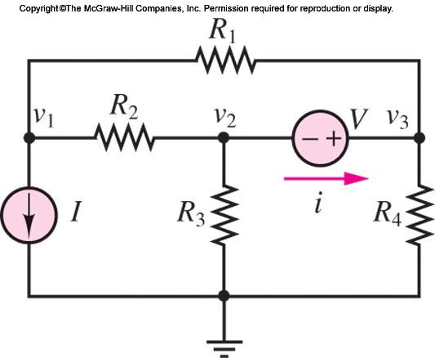
Review of Analysis Methods by Examples
Example (3.6. textbook, Pages 73)
Use node analysis to determine the current i flowing through the voltage source in the circuit of Figure 3.11.

Slide 10
Review of Analysis Methods by Examples
Example (3.6 textbook, Pages 73)
Known Quantities: Resistance values; current and voltage source values.
Find: The current i through the voltage source

Slide 11
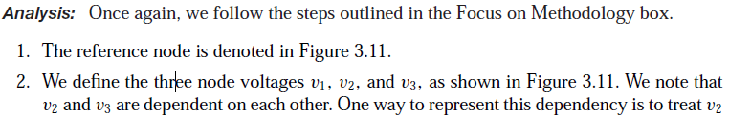
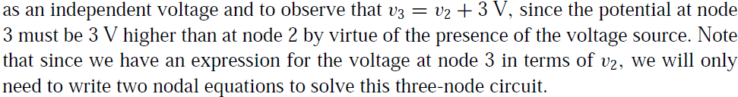
Review of Analysis Methods by Examples
Example (3.6 textbook, Pages 73)
Known Quantities: Resistance values; current and voltage source values.
Find: The current i through the voltage source

Slide 12
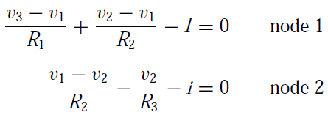


Review of Analysis Methods by Examples
Example (3.6 textbook, Pages 73)
3. We apply KCL at the two nodes associated with the independent variables v1 and v2:
where
Rearranging the node 2 equation by substituting the value of i yields

Slide 13
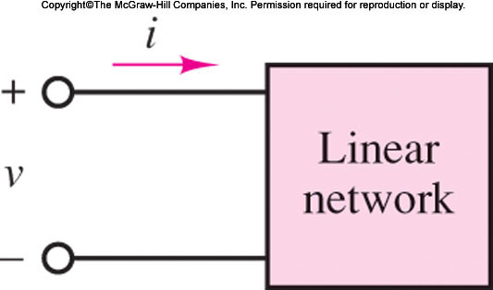
One-Port Network and Equivalent Circuits
Source-load representation, each block—source or load—may be viewed as a two-terminal device, described by an i-v characteristic

Slide 14
One-Port Network and Equivalent Circuits
This configuration is called a one-port
network and is particularly useful for introducing the notion of equivalent circuits.

Slide 15
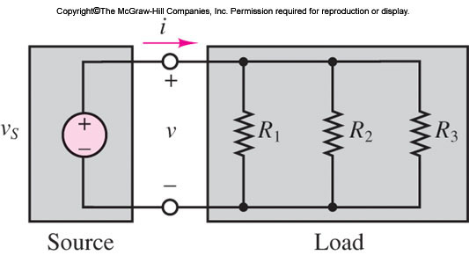
One-Port Network
Determine the source (load) current i in the circuit of Figure 3.32, using equivalent resistance ideas.

Slide 16
One-Port Network
Determine the source (load) current i in the circuit of Figure 3.32, using equivalent resistance ideas.

Slide 17
One-Port Network
Known Quantities: Source voltage; resistor values. Find: Source current.

Slide 18
One-Port Network
Known Quantities: Source voltage; resistor values. Find: Source current.

Slide 19
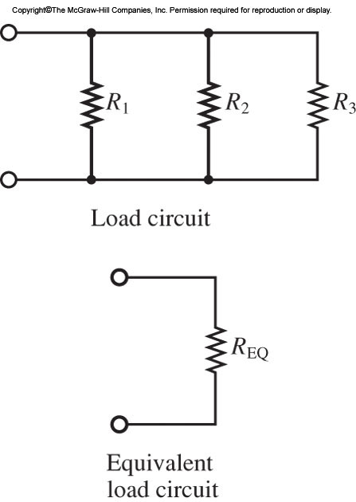
One-Port Network

Slide 20

One-Port Network
Assumptions: Assume the reference node is at the bottom of the circuit.
Analysis: Insofar as the source is concerned, the three parallel resistors appear identical to a
single equivalent resistance of value

Slide 21

One-Port Network
Thus, we can replace the three load resistors with the single equivalent resistor REQ, as shown
in Figure 3.33, and calculate

Slide 22
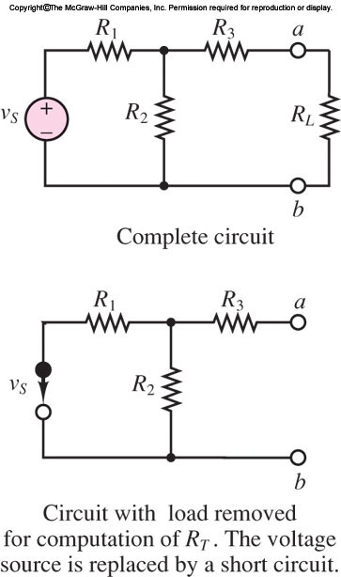
Thévenin Equivalent Resistance
This is done by setting all sources in the circuit
equal to zero and computing the effective resistance between terminals.
Voltage sources are replaced by short circuits;
current sources, by open circuits.

Slide 23
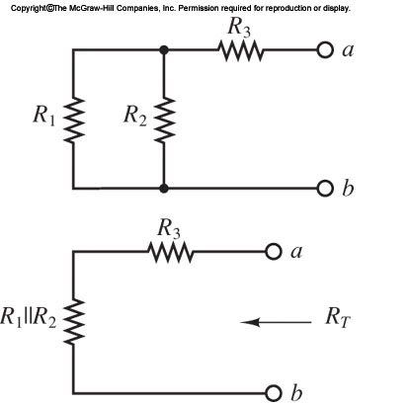
Thévenin Equivalent Resistance
To illustrate the procedure, consider the simple
circuit of Figure 3.36; the objective is to compute the equivalent resistance the load
RL “sees” at port a-b.

Slide 24
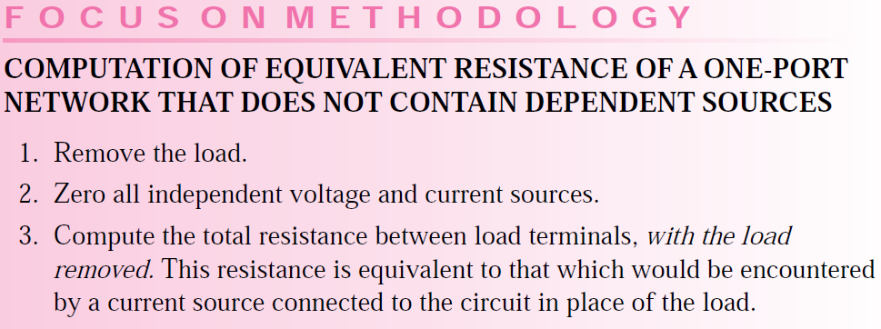
Thévenin Equivalent Resistance

Slide 25
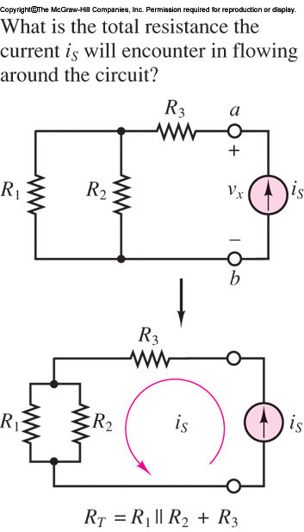
Thévenin Equivalent Resistance -Example

Slide 26
References
Giorgio Rizzoni, “Fundamentals of Electrical Engineering”, McGraw- Hill Education, 2009. ISBN. 978-0-07-338037-7
Peyton Z. Peebles (Author), Tayeb A. Giuma, Principles of Electrical Engineering (Mcgraw Hill Series in Electrical and Computer Engineering), Mcgraw-Hill College, 1991.
Allan R. Hambley, Electrical Engineering: Principles and Applications, Prentice Hall, ISBN-0132130068, 9780132130066, 2011.

